Slide 1
Job Hunt, Resume and Interviews: Teaching Students How to Land their Dream Job
Richard Fruscione, MA, CST, FAST
Associate Professor and Chairperson of the
Department of Allied Health, Mental Health and Human Services
Kingsborough Community College City University of New York
Kendra Thompson, AGS, CST, ST-R
Surgical Technology Program Director
Northwest Technical Institute

Slide 2
OBJECTIVES
From the perspective of educators/mentors to students/graduates:
Job Hunting / Organizational strategies
Resume and Cover Letter Writing
Creating your Personal Brand
Networking
Mastering the Interview
Life after graduation
Self-care and Time Management

Slide 3
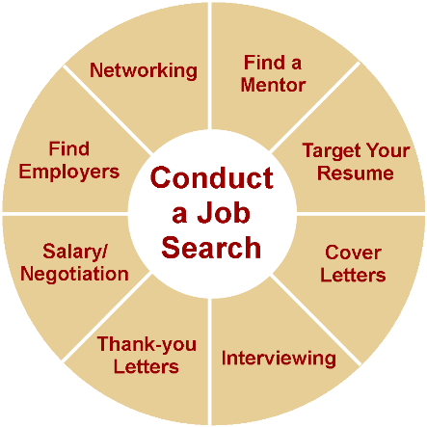
Job Hunting
Where to start
Clinical experience

Slide 4
Networking / Getting into a Hidden Job Market
Ongoing, lifelong process
It’s not what you know, it’s who you know
Shake hands
85 percent of available jobs are never advertised
It’s not, “ Do you know if there is a job available?”
Instead try, “ If you were me, who else would you talk to in order to learn about possible jobs?”
Don’t ask for a job…ask for information
30% converted internships or previous jobs into permanent career positions.
25% utilized online resources to find their positions, including job boards, employer web sites.
55% Direct networking/employer contact methods, including job fairs and on-campus interviewing
“The best time to plant a tree is 20 years ago. The 2nd best time is right now.”

Slide 5
Scenario
"Joe, I just graduated and I'm really strapped for cash. Do you know of any open positions in your department?"
You've put Joe in a very difficult position. Sure, he can sympathize with your situation, but he may not be able to offer you a job. Perhaps he's not in a position to refer you, or there's a hiring freeze, or there aren't any openings right now. Whatever answer Joe gives you, it's bound to be disappointing. So to redeem himself, Joe says, "I don't know of any open positions, but why don't you give me your resume and I’ll give it to my manager." Bad move. Unless your skills match a specific opening in the company at that point in time, your resume is bound to never be looked at. Joe will feel that he's done what he can for you, but you will be no better off.

Slide 6
A more positive approach
"Joe, as you know, I most recently worked for a central sterile department. I know that you've been in the OR as a CST for the past 15 years, and I'm very interested in learning more about your role in the OR. I don't expect you to know of any open positions at your hospital, but I'd like the opportunity to speak with you briefly to learn more about the cases you do and the people that you work with."

Slide 7
Resumes
Formatting
One page
Aesthetically appealing without being too colorful
Templates
Do’s and don’ts
Objectives
High School
I scrub, I gown, I glove, I set-up, I break down…
Customized for the job you are applying for
One size does not fit all

Slide 8
Formatting is essential
Clinical Experience
Education
Relatable Work Experience
Professional Development
Technical knowledge applied to the job you are looking for
Qualifications by relevance
Quantify your experience
Reverse chronological order (this is what employers are used to)

Slide 9
Cover letters
A cover letter typically accompanies each resume you send out. Your cover letter may make the difference between obtaining a job interview and having your resume ignored, so, it makes good sense to devote the necessary time and effort to writing effective cover letters.
highly dedicated healthcare professional that is interested in advancing my career as a certified surgical technologist
I can exercise my established surgical conscience and critical thinking skills in your operating room.
grown professionally, working with a wide variety of surgeons, specialties, and surgical techniques
My adaptability to any surgical setting and compatibility with the surgeons and staff of many services is a characteristic I am proud of, but it is only a small part of my capability to serve each and every patient with kindness, compassion and respect.
work harmoniously with management, circulating nurses and other healthcare colleagues.
offer professional assertiveness with strict adherence to aseptic technique and hospital policies
alert and ready for emergency situations in a fast-paced environment.
FINAL POWER STATEMENT - I welcome the opportunity to prove this all to you by scheduling an interview at your convenience. Thank you for taking time to consider my interest in working with you.

Slide 10
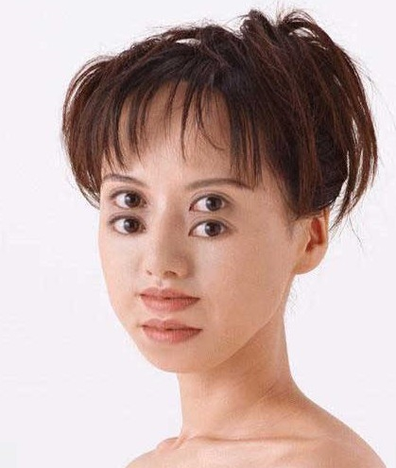
Two sets of eyes are better than one
Review
Proofread
Proofread again
Read it out loud
Read it to a friend or family
Spell check…
the old fashioned way…do not rely
On Microsoft Word….REMEMBER that-
Hemostasis changes to homeostasis

Slide 11
Journaling
Journal
CONTACT Name:
date of 1st contact:
Phone number:
Email address:
Hospital/Employer:
Address:
5 facts about the employer:
1.
2.
3.
4.
5.
FOLLOW UP:
Date:
Email/letter/phone call
Result:
INTERVIEW SCHEDULED:
Key takeaways from interview:

Slide 12
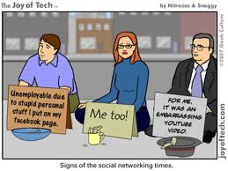
Personal Branding Social Media Platforms
DON’T
Keg stands/drinking/smoking references
Strong Political Statements
Negative work/customer experiences
Irrelevant viral content/spam
DO
Professional look
Interest in Surgery
Positivity

Slide 13
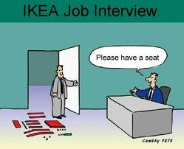
Interview
Preparation
Script for interview responses
Expect the unexpected
Be prepared to ask questions
Dress Code / Body Language
Dress your wage
Positive spin on negative information
Never Lie!

Slide 14
Thank you letters / follow ups
Within 2 business days
Good manners
Find a personal connection
Appreciation for their interest
Reiterate your interest
Remind them of your qualifications
Follow up with any new information they may have asked you to provide
Keep the line of communication open

Slide 15
Graduation Enjoy the moment Remain focused

Slide 16
FIRST JOB
May not be your dream job
May not have anything to do with how you imagined you would work in the operating room or having the schedule and specialty you desired.
That is okay.
The next 40 years of your work life will be spent building your career toward your goal anyway, so spending a few years experimenting in other specialties and learning skills outside your specialty will only make you a more marketable candidate.

Slide 17
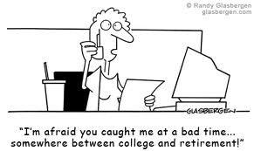
WHERE ARE MY FRIENDS?
You may not see your friends as often anymore, or your social group may change entirely.
Becoming a Surgical Technologist is not only a momentous step in your life; it is also a more tumultuous change than is given credit for.
It is only natural that people drift off to do their own thing based on their priorities. With the blessing that is social media, this need not be as drastic of a change as it was for the generation before us. In time you will find your own set of friends, old or new

Slide 18
Value Yourself
Someone will always be doing better than you
The best thing to do in such a scenario is to remember that your accomplishments are not valued in comparison to another individual’s.
Don’t let anyone bully you into their perceived timeline
VISION BOARD
-Keeping either a physical or a mental list of your own personal achievements and goals can also help you focus on what is truly important – you.

Slide 19
Take Care of Your Own Progress
There will not always be someone to commend your efforts and your accomplishments will not have a GPA value attached to them, which may make them seem insignificant.
This is not the case, however. The adult world is not made of gold stars and progress reports and accepting and adjusting to it is simply a necessary step to being your own person.
Updating your resume every year (pick a specific time, like your birthday week) to add to your accomplishments, recognize areas for growth

Slide 20
TIME (OR LACK OF IT)
Time that was otherwise spent with coffee in a corner of the library completing assignments is now time that you have to explore interests and hobbies than you have been putting off for years.
REINVEST IN YOURSELF
If you haven’t picked up a novel in a while because of all the course related readings assignments that had to be finished, if you haven’t made an actual meal in between all the ramen that was scarfed down or even if you have been putting off on a TV show you have been meaning to watch – now is the time.

Slide 21
QUESTIONS
So, what do you do?
So, that’s like a nurse?
Why don’t you just go to Nursing School?
Finally, the well-meaning concerns and incessant questions from everyone you know will not stop, at least for a while. Learn to block them out or keep your tried and tested answers at the ready.
Remember, you are the only person who needs to know your achievements and why they matter.

Slide 22
QUESTIONS
Kendra Thompson, AGS, CST, ST-R
Surgical Technology Program Director
Northwest Technical Institute
709 S. Old Missouri Rd.
Springdale, AR 72765
kthompson@nwti.edu
scrubmomof2@gmail.com
Richard Fruscione, MA, CST, FAST
Associate Professor and Chairperson of the Department of Allied Health, Mental Health and Human Services
Kingsborough Community College
Brooklyn, New York 11235
richard.fruscione@kbcc.cuny.edu
richardfruscione@hotmail.com
https://www.facebook.com/NYMinuteResume

